Slide 1









The Role of
Social Inclusion in the Pursuit of Happiness:
A Panel Data Analysis
Presented by:
Abdul Hakim Bin Kamalur Rahman (24015257)
Annabel Ching Ke Xin (24002685)
Divani A/P Arumugam (19058908)
Harresh A/L Ragunathan (19076090)
Harimanjato Fanaja Rambonimanana (24036014)

Slide 2
Introduction
Social inclusion is essential for improving well-being
Disadvantaged groups face challenges in achieving social inclusion
Equal access to resources, support, and economic opportunities is vital to create a happy society.
There is a need to explore how social inclusion can enhance happiness for everyone.

Slide 3

Research Objectives
1
To assess the roles of basic needs, which includes nutrition and medical care, water and sanitation, housing and safety in enhancing happiness.
2
To examine the impact of well-being foundations such as basic education, information and communication, health and environmental quality on happiness.
3
To investigate how opportunities’ aspects such as rights and voice, freedom and choice, an inclusive society and access to advanced education influence happiness.
4
To identify which social inclusion indicators significantly affect nations with different Human Development Index (HDI) levels.
5
To analyse the relationship between social inclusion and happiness using the life ladder scores across countries over time.

Slide 4
Title of the Articles | Objective | Methodology | Findings
Developing Thai Happiness Index ​​(Senasu et al., 2019)​ | To develop a national happiness index to assess the happiness level of Thai people and explore related issues. | Data were collected across 13 Thai provinces using stratified multi-stage and simple random sampling, and the Alkire-Foster method was used to create the Thai Happiness Index ranging from 0 to 1. | The 2017 Thai Happiness Index (THaI0) was 0.506, with 14.6% of the population happy and 85.5% not yet happy. The index supports national well-being policies and can be adapted for other countries.
Macro Socio-Economic Factors that Affect the Happiness Index in Indonesia ​​(Sihombing, 2022)​ | To identify the macro socio-economic factors that influence the Happiness Index in Indonesia. | Panel data regression analysis was employed, with the fixed effects model being the best fit. The model was transformed into the white cross-section GLS model to address heteroscedasticity and autocorrelation issues. | Gini ratio, poverty, and unemployment negatively affect happiness, while HDI, per capita expenditure, and economic growth positively impact happiness.
Investigating the determinants of happiness index in EU-27 countries: a quantile regression approach ​​(Akgun et al., 2023)​ | To examine the determinants of happiness in EU-27 countries, focusing on macroeconomic factors and labour market conditions. | The study uses panel data from the Eurostat, World Bank, and World Happiness Reports, employing ordinary least squares (OLS) and quantile regression models to analyse data from 27 EU countries across eight time points. | Taxes and inflation positively affect happiness, while employment has a negative impact. Financial inclusion’s effect varies by income, and GDP boosts happiness mainly in wealthier countries.
Social Inclusion Attitude, an Insight among Teachers from Disadvantaged Areas ​​(Mares et al., 2024)​ | To explore the perspectives of teachers in disadvantaged rural high schools and identify models and future strategies for support. | The research utilized a 23-item questionnaire administered online to teachers in the North-East region of Romania, with responses analysed using the SPSS software. | The findings show that most teachers are interested in social inclusion but lack practical experience and find working with families challenging.
Social exclusion reduces happiness by creating expectations of future rejection ​​(Sjåstad et al., 2021)​ | To understand how social exclusion lowers happiness by making people expect future rejection, and to see how a sense of belonging can reduce this effect. | Participants were assigned to social exclusion or inclusion scenarios via a guided imagination task and measured on exclusion, future rejection expectations, and happiness using self-reported scales. | Social exclusion has a long-term negative impact on happiness, largely due to the anticipation of further rejection which worsens mental health.

Slide 5

Nature of Variables
DV: Life Ladder (Happiness Index)
IVs: include 148 countries, year (2011-2022)
Social inclusion indicators
Basic Human Needs
Foundations of Wellbeing
Opportunity
Nutrition and Medical Care
Water and Sanitation
Housing
Safety
Basic Education
Information and Communications
Health and Wellness
Environmental Quality
Rights and Voice
Freedom and Choice
Inclusiveness
Advanced Education

Slide 6
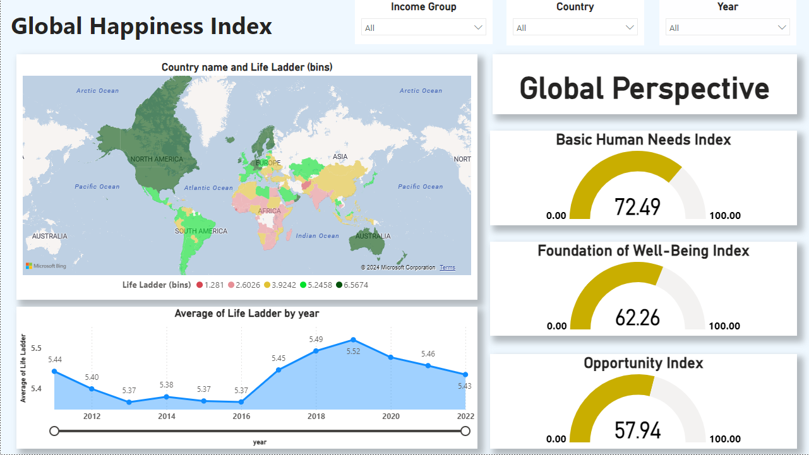

Slide 7
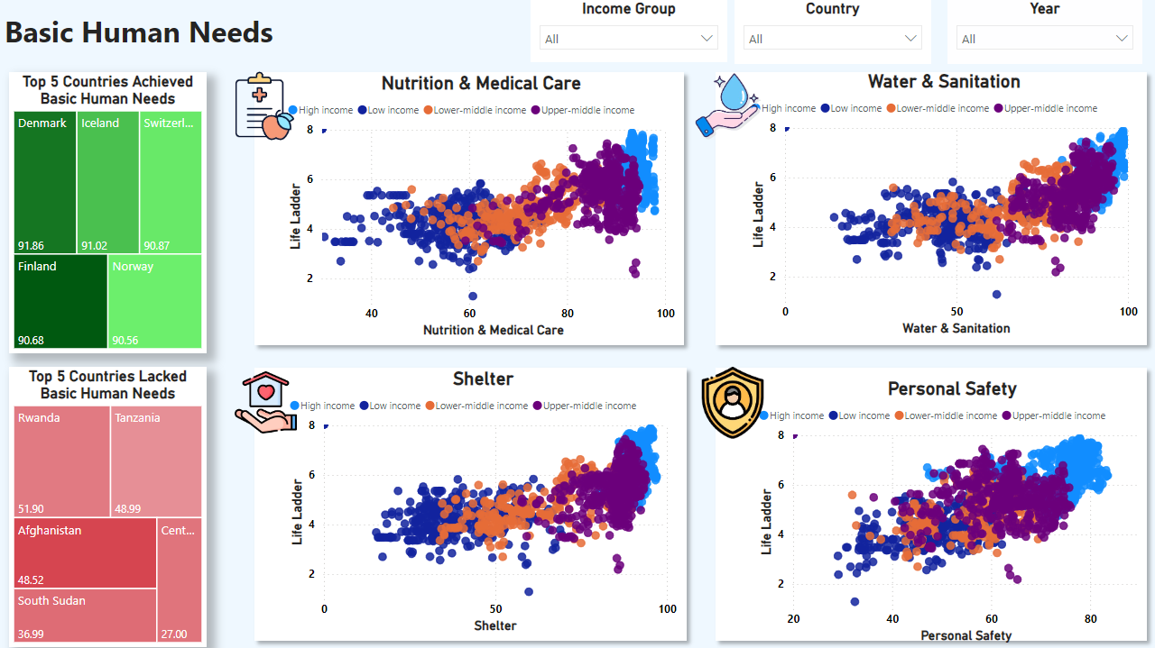
1
To assess the roles of basic needs, which includes nutrition and medical care, water and sanitation, housing and safety in enhancing happiness.
4
To identify which social inclusion indicators significantly affect nations with different Human Development Index (HDI) levels.

Slide 8
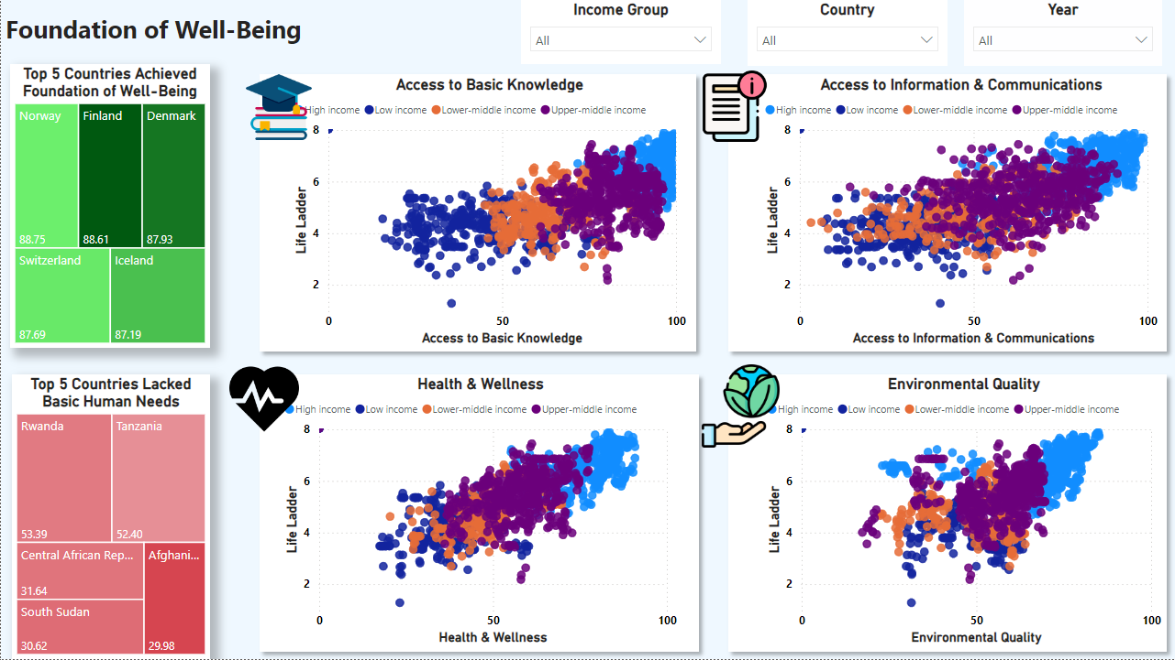
2
To examine the impact of well-being foundations such as basic education, information and communication, health and environmental quality on happiness.
4
To identify which social inclusion indicators significantly affect nations with different Human Development Index (HDI) levels.

Slide 9
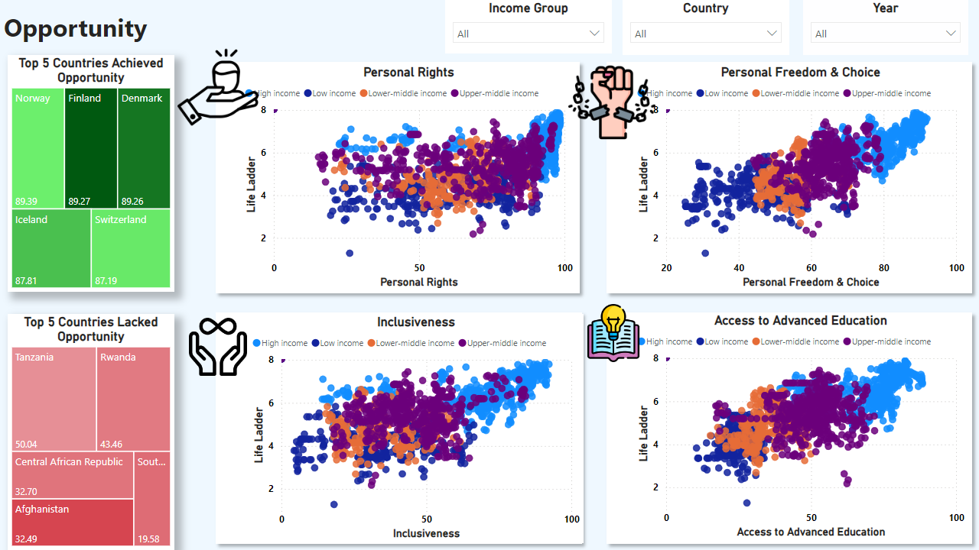
3
To investigate how opportunities’ aspects such as rights and voice, freedom and choice, an inclusive society and access to advanced education influence happiness.
4
To identify which social inclusion indicators significantly affect nations with different Human Development Index (HDI) levels.

Slide 10
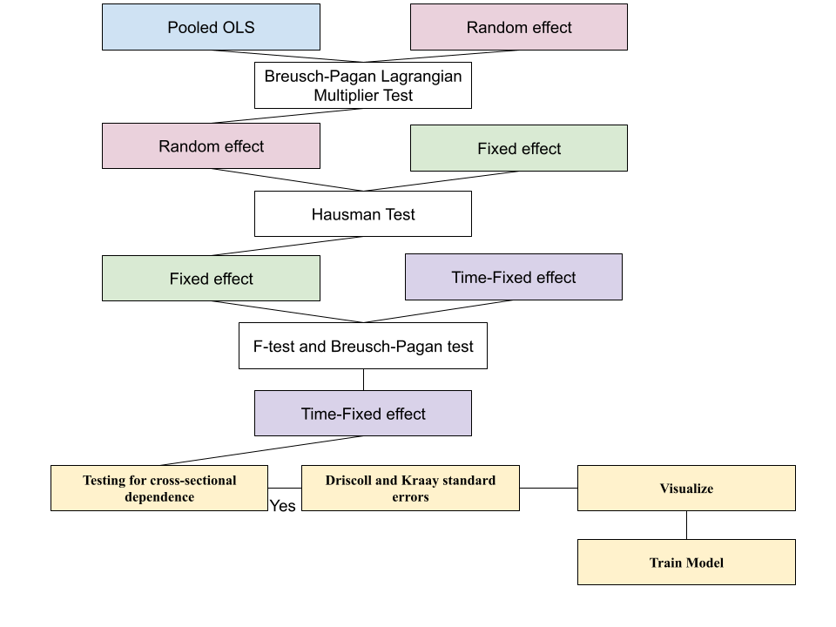
MODEL SELECTION

Slide 11
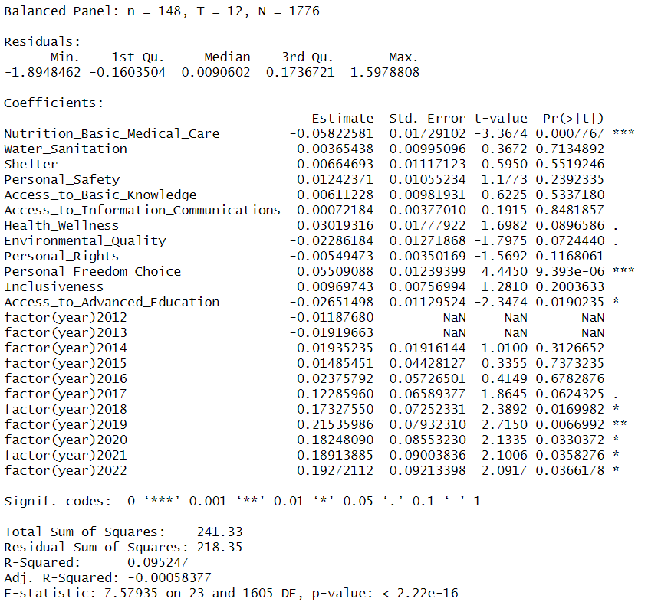
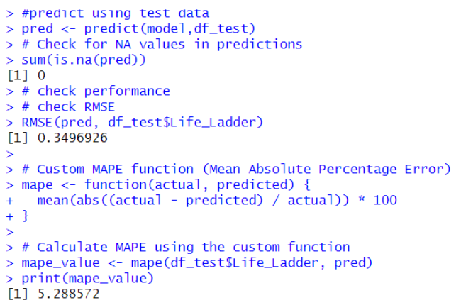
5
To analyse the relationship between social inclusion and happiness using the life ladder scores across countries over time.
R-Squared: 9.52%
RMSE: 0.35
MAPE: 5.29%

Slide 12
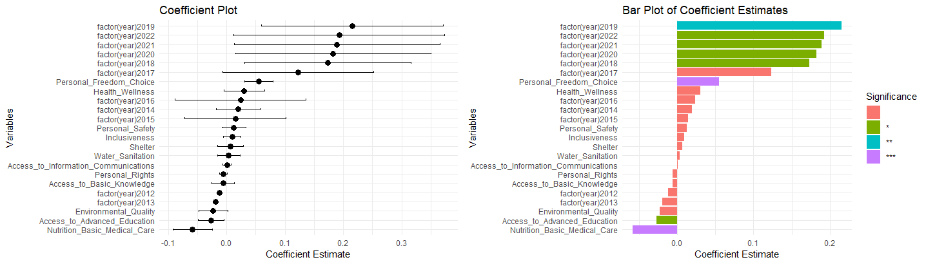

Slide 13

Nutrition & Medical Care
Poor quality
Inequalities in access
High costs
Access to Basic Knowledge
Stress
Frustration
Access to Advanced Knowledge
Stress
Competition
Peer pressure
Personal Rights
Environmental Quality
Political stability
Cultural context
Awareness of inequalities
Short-term disruptions
Personal sacrifices
Costs

Slide 14
Conclusion

